Slide 1
Project Purpose
Technologies, Social Media, and Society: Current Topics 717J
For this project, I have created a PowerPoint presentation that gives students a point-by-point table of reference for determining the quality of sources, what is fact and what is fiction, and how to determine the importance of the information. This project should be detailed enough to explain all aspects of this project, including giving examples and sources students can use. I have provided username and pw in the notes in order for you to access subscriptions.
By Leslie Barnaby M.Ed
Cashman Elementary School
Technology Integration

Slide 2
Information Investigation
Questions ?
Wonderings
Answers
Fact vs. Fiction
How to Research at Cashman Elementary School
By Mrs. Barnaby
2017

Slide 3
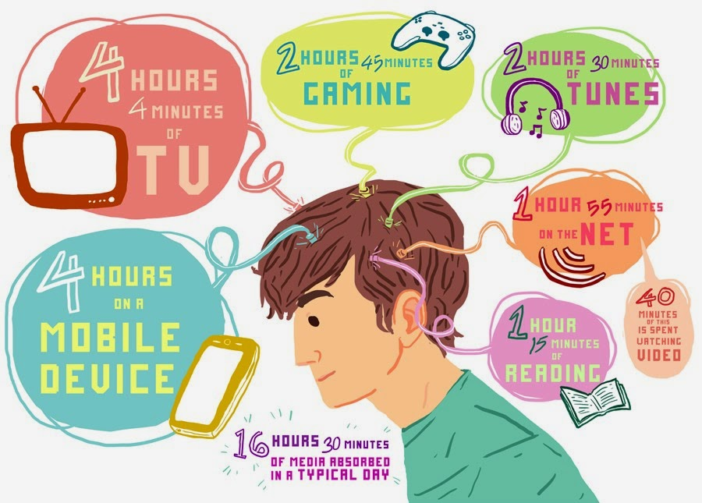
You have grown up in the Information Age. In addition to resources you can find in our library shelves, like encyclopedias, almanacs, dictionaries, atlases, and non-fiction books, you are surrounded by technology resources. Where do you begin? Which is the best route? I will show you the routes easily available at Cashman, your home, and the Amesbury Public Library.

Slide 4
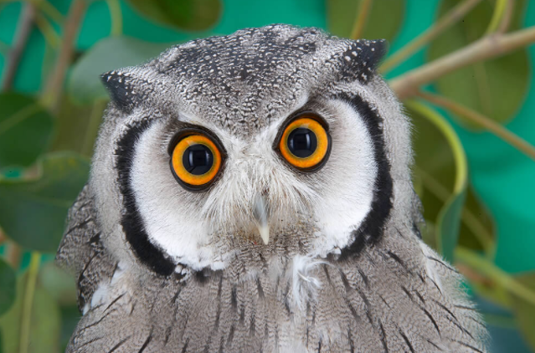
Common Core Standards 4th
Research to Build and Present Knowledge:
CCSS.ELA-LITERACY.W.4.7
Conduct short research projects that build knowledge through investigation of different aspects of a topic.
CCSS.ELA-LITERACY.W.4.8
Recall relevant information from experiences or gather relevant information from print and digital sources; take notes and categorize information, and provide a list of sources.
CCSS.ELA-LITERACY.W.4.9
Draw evidence from literary or informational texts to support analysis, reflection, and research.
Why are we doing this?
Simple Answer:
Teachers are required to follow Common Core Standards. Research is an Important and necessary life long skill

Slide 5
How do you research?
The Big 6 Method
Explanation
Handout
Developed by Mike Eisenberg and Bob Berkowitz, the Big6 is the most widely known and widely used approach to teaching information and technology skills.

Slide 6
The Big 6 information literacy skills can help in the following ways:
Make sure you clearly understand the assignment
Complete a task, research project, assignment, or decision-making activity
Discuss the information process using specific terms
Know if you missed a step in the information process, and identify which one
Self-assess your work before you turn it in for review or grading
Recognize credible information and cite sources
Break any assignment into manageable parts and build confidence.

Slide 7
Here are the six stages we call the BIG6. Two sub-stages are part of each main category in the Big6 model:
1. Task Definition
1.1 Define the information problem
1.2 Identify information needed
2. Information Seeking Strategies
2.1 Determine all possible sources
2.2 Select the best sources
3. Location and Access
3.1 Locate sources (intellectually and physically)
3.2 Find information within sources
4. Use of Information
4.1 Engage (e.g., read, hear, view, touch)
4.2 Extract relevant information
5. Synthesis
5.1 Organize from multiple sources
5.2 Present the information
6. Evaluation
6.1 Judge the product (effectiveness)
6.2 Judge the process (efficiency)
People go through these Big6 stages—consciously or not—when they seek or apply information to solve a problem or make a decision. It's not necessary to complete these stages in a linear order, and a given stage doesn't have to take a lot of time. We have found that almost all successful problem-solving situations address all stages.
6
Handout in Word

Slide 8
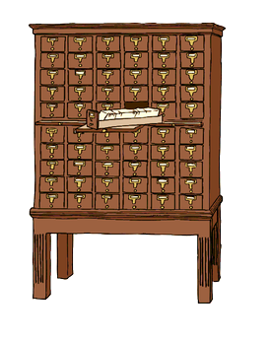
Databases:
Collection of Information
In the school library we have Follett Destiny to manage all the books in the library. They have a section to search for books.
Keyword
Title
Author
Subject
Series
You can also choose reading level of material type. I put in the word saffron. There are no book titles about saffron. I used Keyword and Subject.

Slide 9
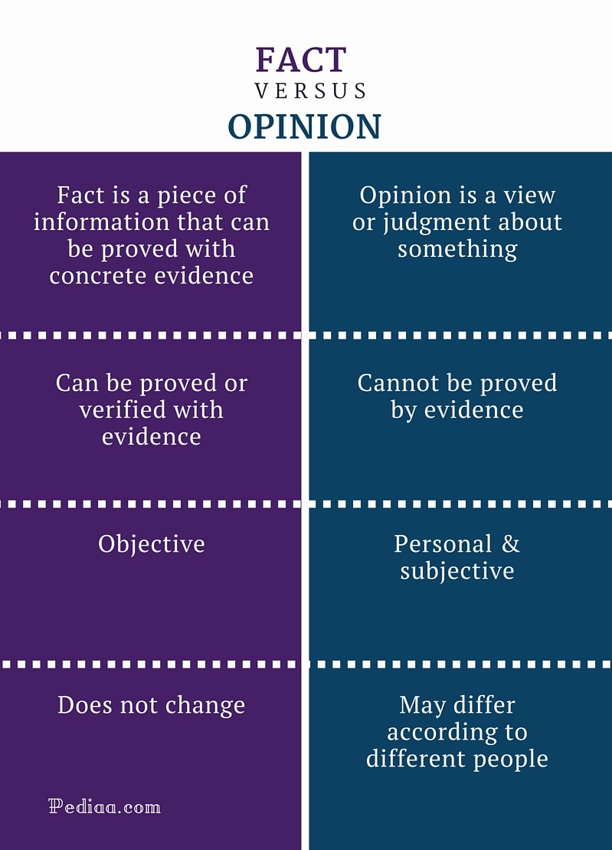
Fact vs. Fiction
After watching this cute you tube video, I want you to talk to your partner and share an example of a fact and an opinion. See if they can identify which is which. Click below
https://www.brainpop.com/english/writing/factandopinion/
Notes:
User: lbarnaby
Pw: Cashman2016!bp

Slide 10
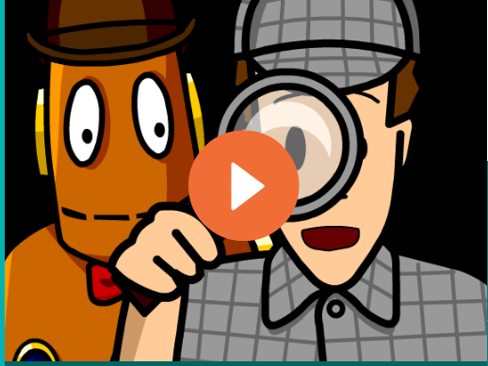
Internet Sources
Suffixes
.edu= educational or an academic institution
.gov= a government sponsored web site, usually has a U.S seal or logo
.com=. is treated as the default for Web addresses, both commercial and non-commercial
.org= organizations commonly believed to mainly host non-profit organizations
.net= network (comcast.net)
Check list to determine whether a site is trustworthy research source. Can you find?
Publisher
Author
Biased
In-depth
Up-to-date
We have been using Brainpop for over 5 years.
It is what we use to teach safe practices in using the internet. I find it very useful for introductions to new concepts, especially abstract topic like the internet. Click on Tim and Moby above to learn about how to judge web sites for authenticity and trustworthiness.
Notes:
www.brainpop.com
User: lbarnaby
Pw: Cashman2017!bp
Online Sources

Slide 11
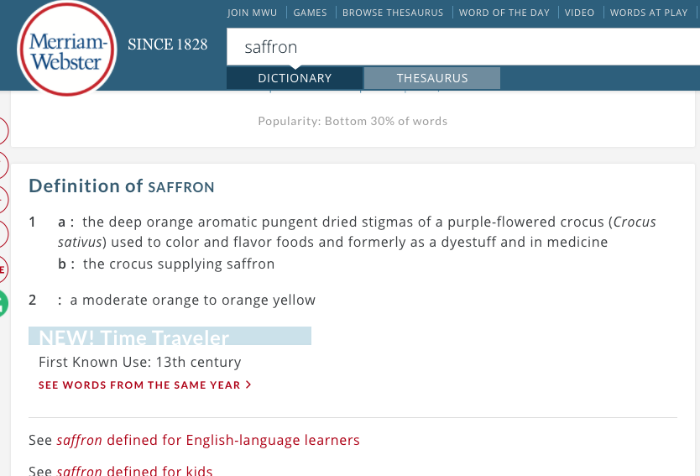
Can I Google It?
The answer is YES, but you must use a CIPA Compliant Search Engine, one that will filter out adult or inappropriate material. There are many new search engines, but here are two that you can use. Click them and do a search to see how they work. You will find many listings, but which ones are educational sources not promotions or advertisements? I looked up saffron and found a dictionary definition.
Google

Slide 12
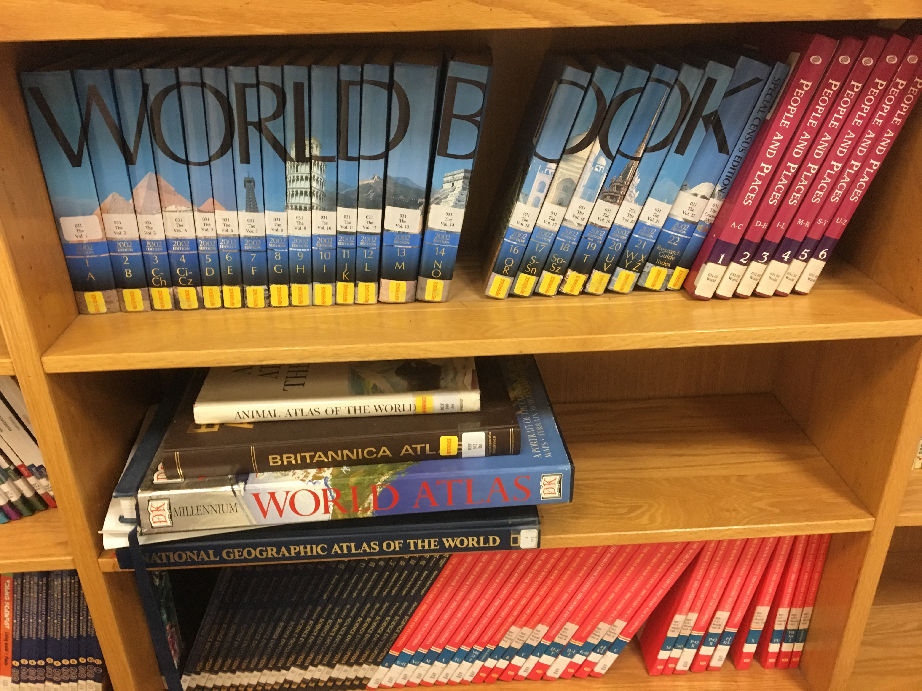
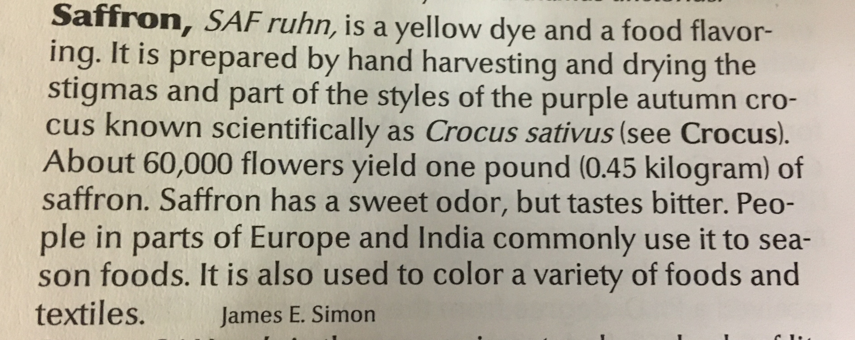
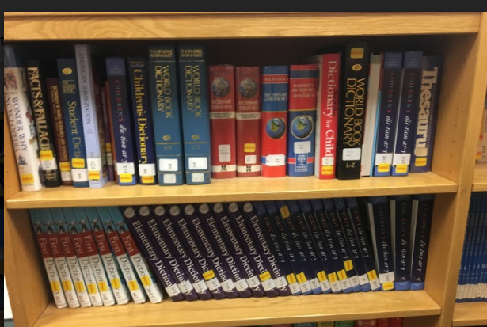
Encyclopedias, Atlases, and Dictionaries
I looked up saffron in each set and it has a little more than a definition. I still have questions. Why is it so expensive to buy? I need more sources.
We have World Book 2002 and 2006. Many schools are turning to online encyclopedias. They are fine to use, but do to their date, you may want to find more up to date information. Also, our encyclopedia may be difficult for some to read as they are at a high reading level. We also have specialized encyclopedias on Animals and People and Cultures.
We have Atlases for Maps, both US and World Atlases.
In addition we have dictionaries. Some are English, but many represent languages that are spoken by some of our students.

Slide 13
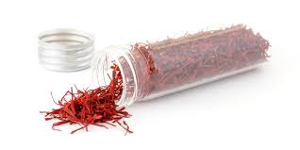
Online Resources
Click
Click to launch
This is new to our collection. Right now we have Animals and Biographies. This site will automatically read the information to you. It is for younger kids or for our ELL students just learning English.
trusted
This is a leveled vetted resource. It is made for elementary and above. Level 1 is for lower elementary. Level 2/3 Upper Elementary to adult. I did a search for “saffron” look what I found! Click on the picture of saffron, see how much more information I have found. Look at the middle video and find out why it is so expensive.
Click
Brainpop is Awesome for Introduction and Facts
Notes:
Pebble Go
User: Amesbury
Password: read
Lbarnaby
Cashman2016!bp

Slide 14
What’s Important Taking Notes
Graphic Organizers
Note the title and scan the page
Read the paragraph,
Note Keywords ( Nouns/Verbs)
Note the explicit topic sentence
Read captions, illustrations, underlined words, Italicized and bold words.
Repeat for each paragraph
Note the explicit main idea
Note the implicit main idea ( inferred)
Be sure to write down the title of the book/site, publisher ,author and year. If it is an internet site, write the link.
Depending on your task and where you are in the research process, I have a series of graphic organizes to keep you focused and on task. Your teacher may have one that she wants you to use.
Notes:
Pebble Go
User: Amesbury
Password: read

Slide 15
In the elementary level, it is a learning process:
Ask questions
Find Resources
Read and Research
Take Notes
Organize and write essay
Edit/Peer Edit
Publish
There are so many sources, but finding the one that works for you takes time and support.
The adults in school, home, and library are your best resource and willing to support you.
Research takes time and you must be a discernable user. Use vetted resources and be sure to use more than one source to cross check facts. Just because it is written, published, or uploaded, does not make it a fact.
Enjoy
Learning
Notes:
Pebble Go
User: Amesbury
Password: read

Slide 16
The
End
Notes:
Pebble Go
User: Amesbury
Password: read

